Slide 1
Introduction to Graph Neural Networks – Additional Resources
NVIDIA DLI

Slide 2

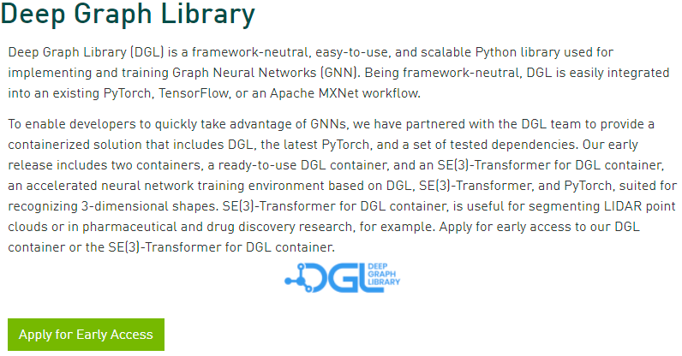
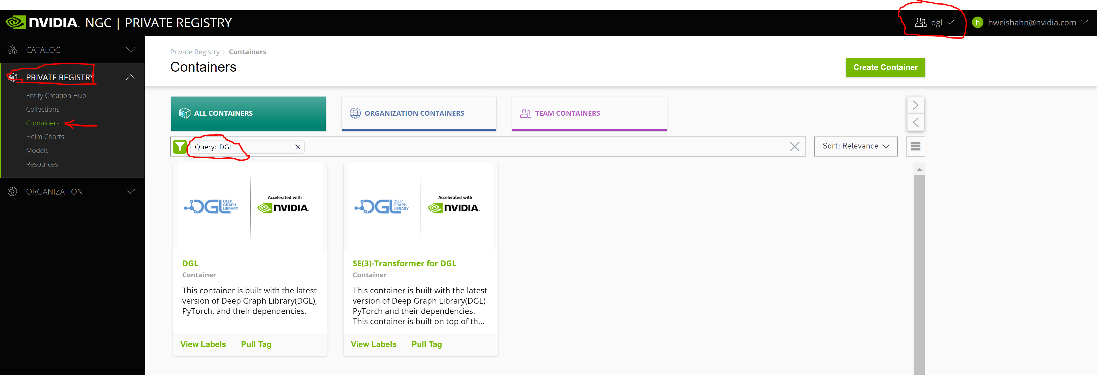
Installation
NVIDIA DGL containers on NGC (Blog)
NVIDIA has partnered with the DGL team. Our early release consists of two containers:
DGL container (early access): the latest versions of DGL and PyTorch, their dependencies, and the latest performance optimizations to run code with GPU-accelerated performance immediately
SE(3)-Transformer for DGL container: accelerated neural network training environment based on DGL, SE(3)-Transformer, and PyTorch. Suited for recognizing 3-dimensional shapes, for segmenting LIDAR point clouds or in pharmaceutical and drug discovery research

Slide 3
Message Passing
Message Passing Neural Networks
Below are some additional resources that will help you understand the message passing paradigm, which can be used to create learnable message functions for more advanced graph neural networks:
DGL – https://docs.dgl.ai/en/0.8.x/guide/message.html
PyTorch Geometric - https://pytorch-geometric.readthedocs.io/en/latest/notes/create_gnn.html

Slide 4
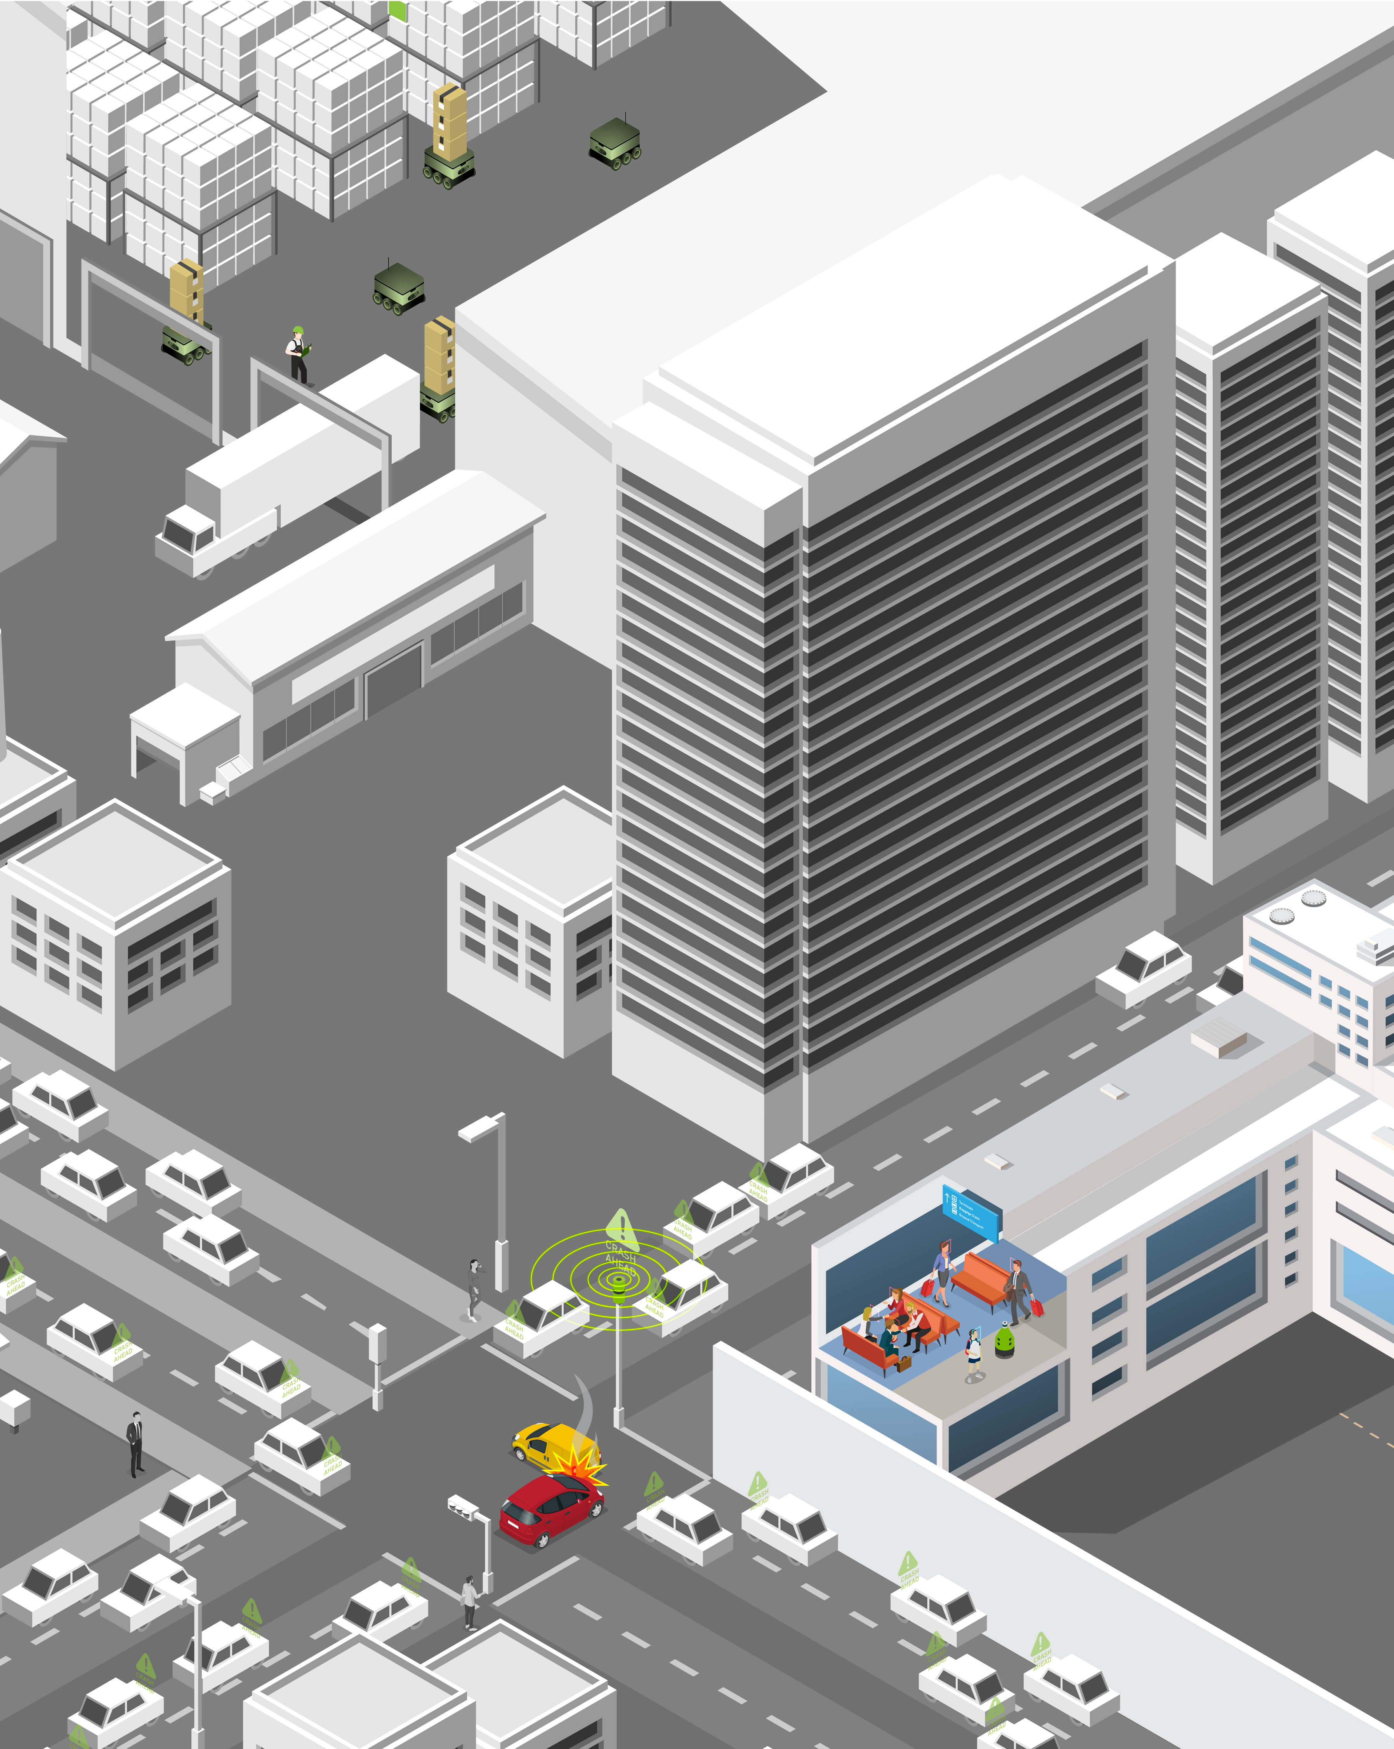
Further literature
[INTRO] “A Gentle Introduction to Graph Neural Networks” Sanchez-Lengeling et al., Distill, 2021, distill.pub/2021/gnn-intro/
[INTRO] “Understanding Convolutions on Graphs” Daigavane et al., Distill, 2021, distill.pub/2021/understanding-gnns/
[REVIEW] “Graph-Based Deep Learning for Medical Diagnosis and Analysis: Past, Present and Future” Aristizabal et al., arXiv, 2021, arxiv.org/abs/2105.13137
[REVIEW] “Graph neural networks: A review of methods and applications” Zhou et al., AI Open, 2021, doi.org/10.1016/j.aiopen.2021.01.001
[REVIEW] “[…] Dynamic Graph Neural Networks: A Survey” Skarding et al., IEEE/arXiv, 2021, arxiv.org/abs/2005.07496

